Slide 1

Before we proceed...
He is the job interviewer:
when you see it, pay attention!
It means: this is a typical interview question for Junior Data Scientist, be ready to answer!

Slide 2
Basic Concepts of
Machine Learning
The basics to orientate yourself

Slide 3
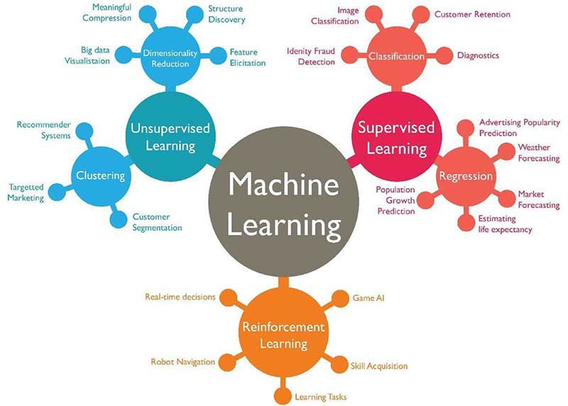
Machine Learning Types

Slide 4

Reinforcement Learning: Learn by experience
We would like to teach to our dog to sit when we say “Sit!”. He must learn to sit guided by our reward (giving food). The dog starts trying actions randomly: when he sits we reward him by giving food. The dog learned with reinforcement.
Agent = dog
Environment = us conditioning the dog with rewards
Policy = best strategy to get a reward
Action = any action
Positive Reward = food
Negative Reward = no food
The dog must LEARN BY EXPERIENCE (try and fail)

Slide 5
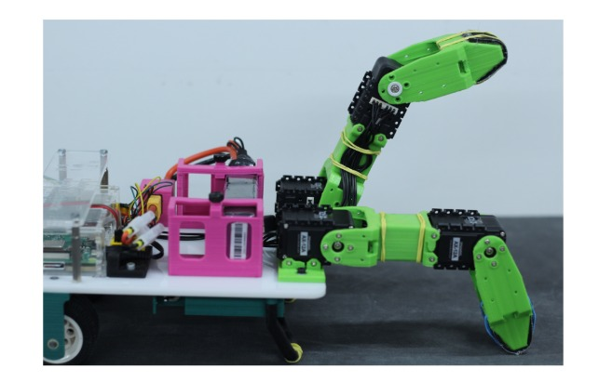
Robot Example Reinforcement Learning
Credit: Thanks to Jan Kaiser! :)
This is a real robot, its goal is to learn crawling forward. It has no instructions, it uses Reinforcement Learning

Slide 6
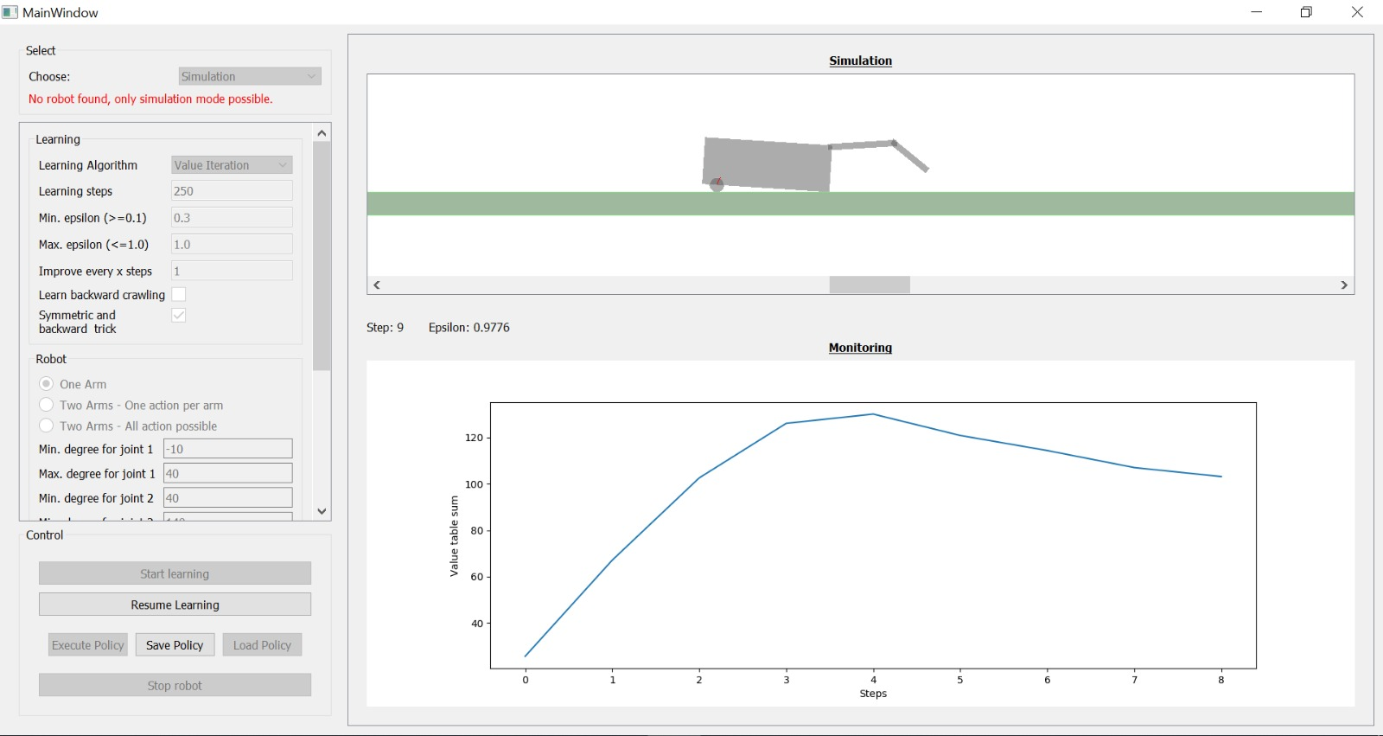
Robot Example Reinforcement Learning
Credit: Thanks to Jan Kaiser! :)

Slide 7
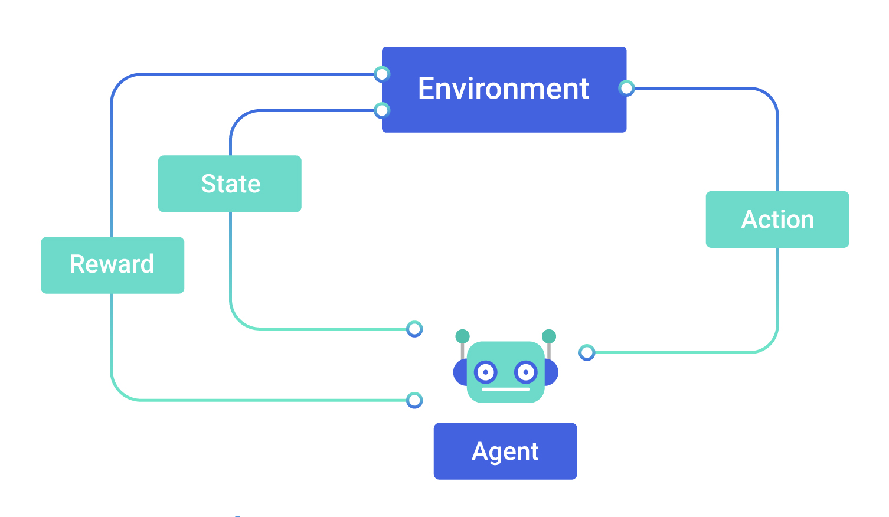
Reinforcement Learning
An Agent must learn a task and the environment guides him providing rewards. He must find the best policy (strategy) to reach its goal. After each action, the state describe the current situation of the agent.

Slide 8
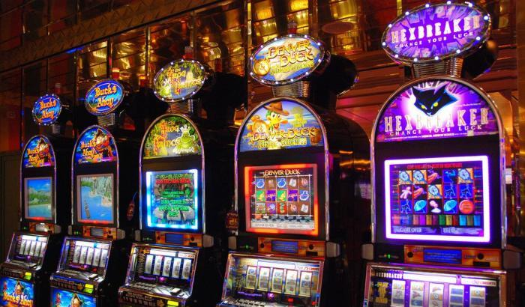
Reinforcement Learning: time to gamble!
You are in a casino, in front of 10 slot machines. You have in your pocket 100 euros, and you have to play the slot machines (in sequence) so that to gain as much as possible at the end. Your goal is to play the correct Slot to win as much as you can.
An agent (us, a robot, or a software) has a goal (gain as much as possible) applying the best strategy (policy) by performing actions. This is the simplest case of reinforcement learning. It is called Multi Armed Bandit (MAB).
Similar to the dog, we have to learn which is the best policy (strategy) to get the maximum reward

Slide 9
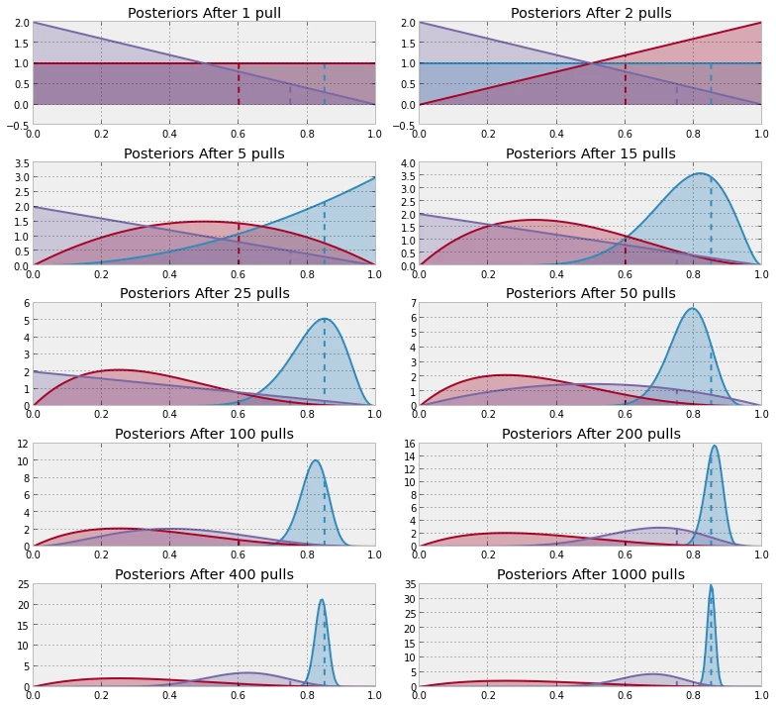

Slide 10
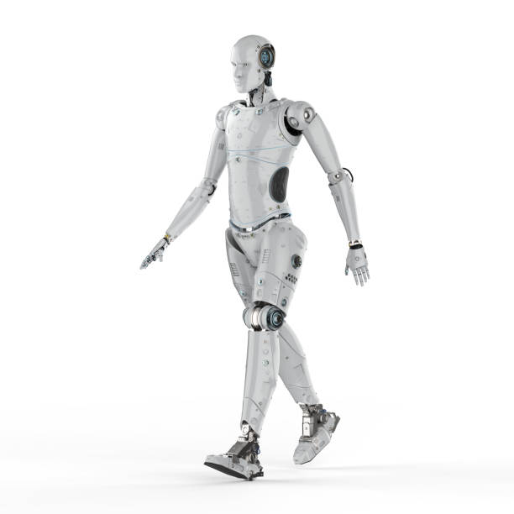
The walking robot
A robot (agent) must learn how to walk, alone, with no instructions, only by experience. So, he randomly tries some actions (exploration).
The environment (gravity) gives it back a positive reward (standing up) or negative reward (falling down).
The state is the position of his legs and articulations and the state describe the current situation.
So we have an agent that perform actions in an environment guiding him with rewards (positive or negative). The state describe the current situation.

Slide 11
Robot Example Reinforcement Learning
Credit: Thanks to Jan Kaiser! :)
An Agent must learn a task and the environment guides him providing rewards. He must find the best policy (strategy) to reach its goal. After each action, the state describe the current situation of the agent.

Slide 12
Q: What is Reinf. Learning and what is Exploration vs Exploitation?
An Agent have a task to learn and must find the best strategy (policy) by interacting with the environment. The environment “guides” the agent giving positive or negative rewards to the agent. The agent interacts with the environment taking actions and each action lead the agent to a new situation (state).
In RL the goal is to have the maximum cumulative reward: this is achieved with a balance between Exploitation of the best strategy reached so far and Exploration of novel policies that could lead to better rewards.
For example, in the slot machines: should the agent continue to play only the most promising slot machine or should try different ones that potentially give better rewards? This is a tradeoff between Exploitation (take the best strategy so far) and Exploration (try different strategies potentially more profitable).

Slide 13


Q: Tell me a good example!
The website banners
Learn how to design the optimal banner to show in the webpage to maximize clicks. We prepare 10 different banners. In this particular case, you can use “Multi Armed Bandit Algorithm”
Goal: maximize clicks on the banner
Reward: +1 if clicked, 0 if not clicked
Environment: customers seeing webpage
Agent: our laptop, trying to offering the best
banner automatically (out of 10)
State: no state in Multi Armed Bandit Algorithm

Slide 14
Machine Learning Types

Slide 15

Supervised Learning Example: Diabetes
We are in a hospital and we have 100k patients: for each of them we measure:
the mean pressure
the mean level glucose in the blood
mean heart rate frequency
We also already know if each patient have Diabetes or not (we know it for sure).
INPUT DATA: pressure, glucose, heart rate
OUTPUT DATA: has diabetes or not (1 or 0) - also called labels
We would like to create a mathematical function describing this relationship INPUT -> OUTPUT. This function is our Supervised ML model. The creation of this function is called TRAINING phase.
Why is it useful to have this function? If tomorrow a new patient we never saw before (never saw in training phase) arrives, we use the trained model to predict if he/she has diabetes or not using his biological parameters.

Slide 16

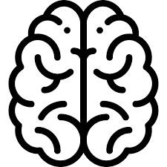
Supervised Learning
In supervised learning, we have BOTH input and output and the model LEARNS and understand the relationship between input and output after a TRAINING PHASE. We use the trained model to PREDICT on never-seen-before inputs.
GOAL of Supervised Learning: PREDICT on new data as input and have an answer as output
INPUT
OUTPUT

Slide 17
Supervised Learning
The model is trained on a TRAINING SET and then we evaluate the performances on a TEST SET (unseen data, that the model never saw before).
In ML we say that the model is a good model when is able to GENERALIZE, meaning that it can predict the output of unseen data.
INPUT
OUTPUT

Slide 18
Types of
Supervised Learning
When we know input and response

Slide 19
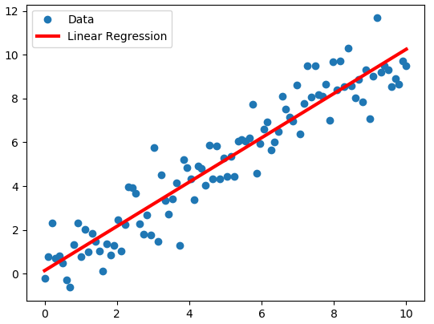
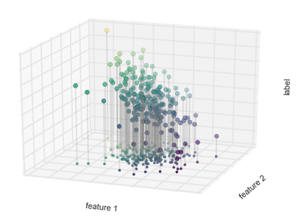
Regression: Predicting continuous labels
Regression is when you want to predict a continuous value (label / target / dependent variable) from the input (features / independent variables). For example: predict the price of the house given the Area of the house. The GOAL of regression models are to find the function that approximates continuous values given the input.
Price
Area of the house

Slide 20
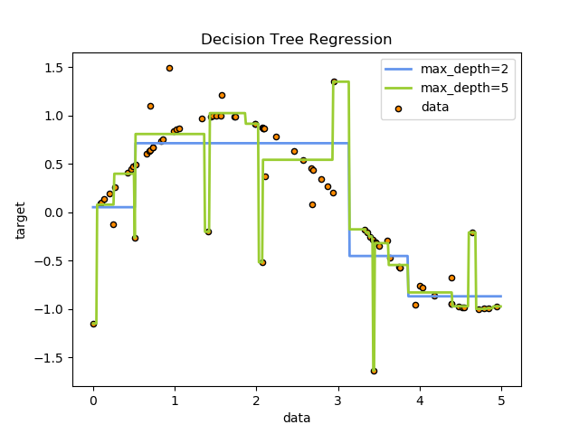
Intuitive overfitting problem in regression
We will see overfitting later in more details. Do you think that that model can generalize well on new data?
The model is a mathematical function to describe data (sort of mapping from input to output).
See the green line: do you think that it will give you reliable estimates of the target values in the future if we give new data to the model and predict the target?
NO! The model is not able to generalize well and did not understand well how to describe data.

Slide 21
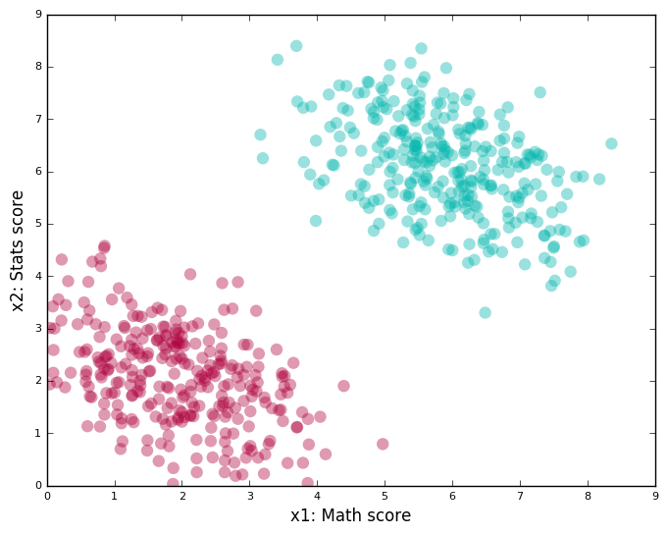
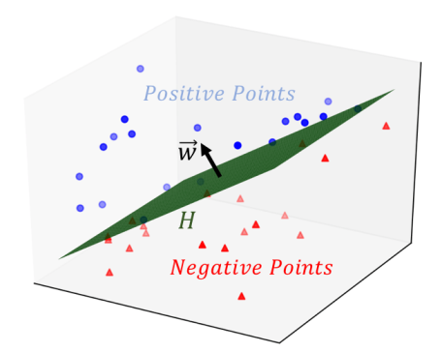
Classification: Predicting discrete labels
Classification is then we need to predict a discrete values (label / target) from an input.
The GOAL is to find the separation line (separation hyperplane in general). For example: a classification task is: given the Glucose level in the blood and Age of the patient, does he have Diabetes or not?
The model can say: well, the patient P has diabetes if he is older than 50 y.o. and have a glucose level above 100.
The model explains the relation between the target and the input
Patient Age
Glucose Level

Slide 22
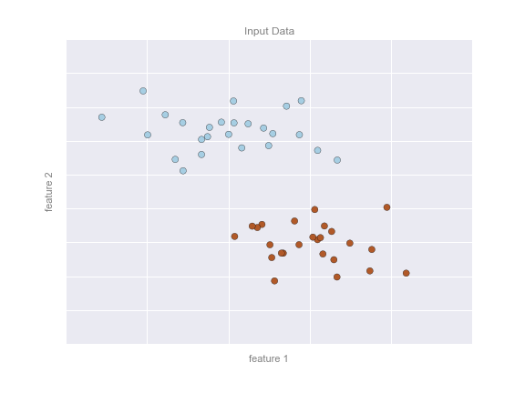
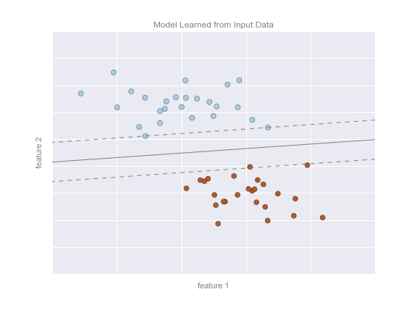
Classification Example: Supervised Learning
A straight line describing the separation between the 2 classes. The weights of the model describe the position of the line
Some data (es: diameter and weight of bananas and apples)

Slide 23
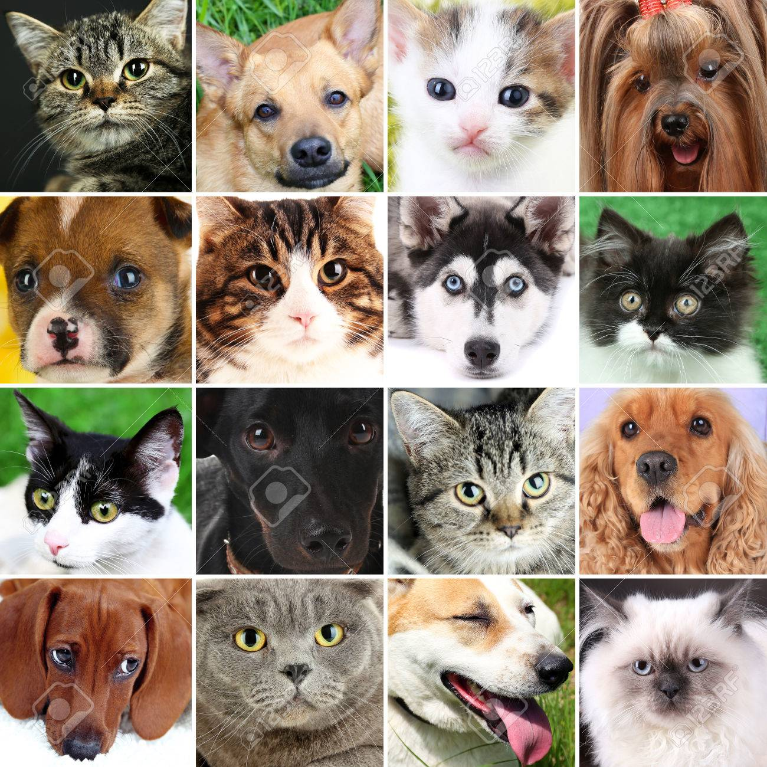
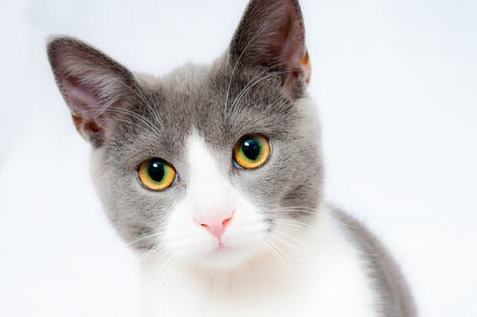
Supervised Learning: cat or dog?
Training the model...
Cat
Dog
And use the trained model to predict on UNSEEN pics!
CAT!
UNKNOWN pic: the model never saw it before during training
PREDICT

Slide 24
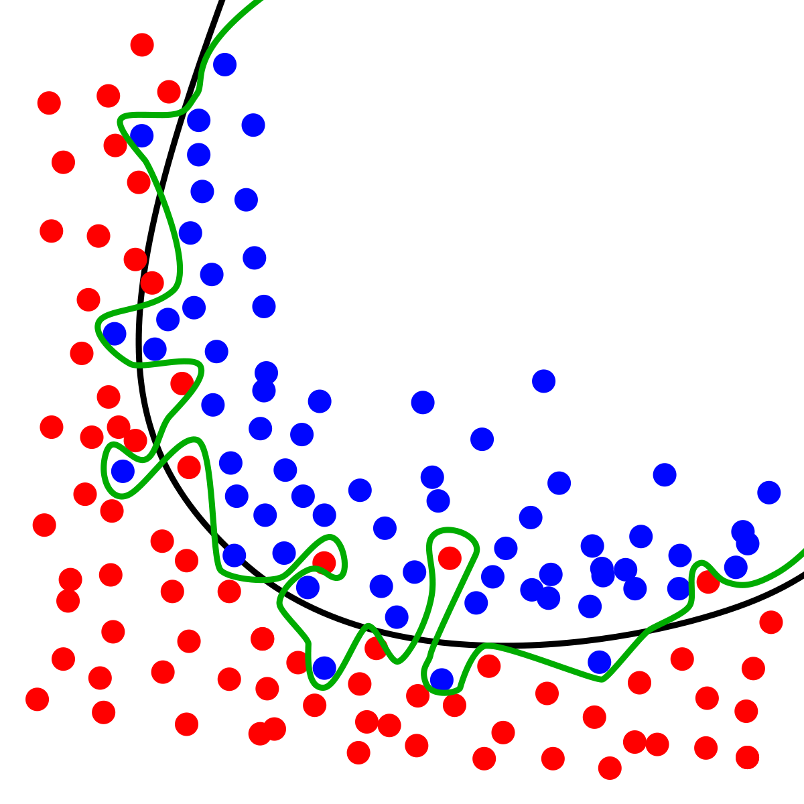
Classification overfitting
Which is the best separation line, properly diving the 2 classes?
The best model is the black line, because when new data arrives it is able to generalize the classes better.

Slide 25
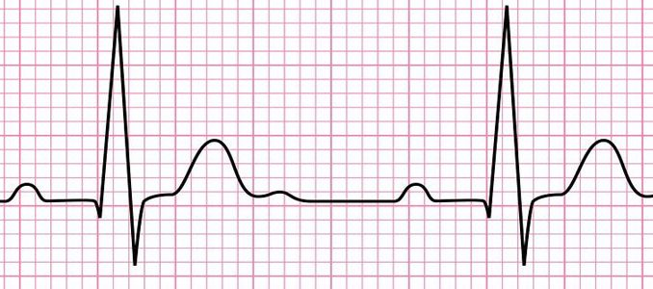
Supervised Learning Example: Diabetes
INPUT recorded from 100k patients
TRAINING
OUTPUT Diabetes or not (1 or 0) from 100k patients
TRAINING SET
SUPERVISED ML MODEL
trained model
INPUT that the model never saw during training (unseen data)
PREDICTED OUTPUT
Diabetes or not (1 or 0)
TEST SET
PREDICTION

Slide 26
Explainability of a Model
Models in Machine Learning find the relation between input and output. This is useful because we can know which are the factors that are more important (or not important) in the phenomenon we are observing.
For example is the model is like above (invented), we can say that the Glucose Level is much more important than Age, because the weight is bigger.
Patient Age
Glucose Level

Slide 27

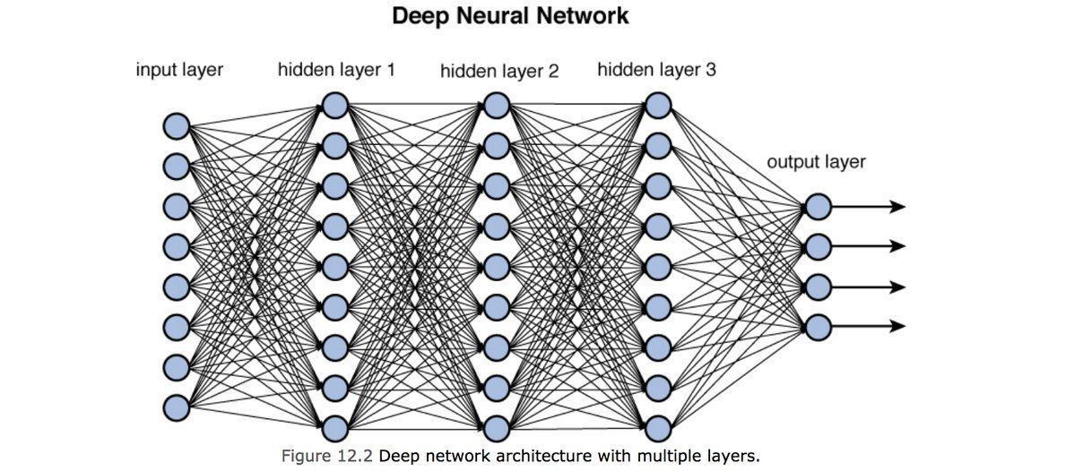

Deep Learning: what is it?
Tensor flow (and Keras) are some of the many libraries used for Deep Learning.
Deep Learning are ML techniques involving Neural Networks to perform both supervised and unsupervised learning.
They are very powerful but they also need a LOT of data to work well

Slide 28
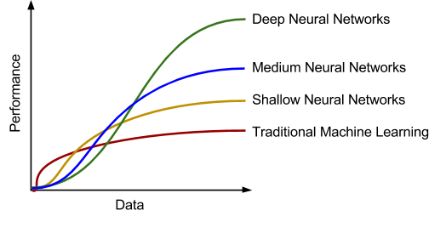
Deep Learning interpretation
They are very powerful but they also need a LOT of data to work well. They are in general much less explainable and interpretable than traditional ML.

Slide 29
Q: What is a supervised ML model?
It depends on the task. In regression our goal is to observe the data we have and find the best mathematical function describing the data. In this case the value to predict is a continuous value. The model “fits” the data and describes the data.
In classification, the model observe the data and predict a categorical value (a class). For example, cat or dog given an image.
In supervised learning, we are trying to build a model that will predict labels for new data.

Slide 30
Machine Learning Types

Slide 31
Unsupervised Learning
Completely different goal from Supervised Learning: the goal here is not predict but:
Unsupervised learning involves models that describe data without reference to any known labels.
The unsupervised learning is able to find similarities in the data and structures.
For example:
find the group of most similar customers and extract a “mean” behaviour
find the group of most similar patients
…
The goal is find patterns and structured in the data

Slide 32
Q: Difference between supervised and UL
In supervised learning, we MUST have BOTH input and labels values and the model is TRAINED (in the training phase) in order to describe the relationship between input and output values. After training phase, the model can be used to predict from input it never saw before during the training(and do an example).
In unsupervised learning we don’t have labels, because we don’t need them. The goal is to find hidden structures and similarities in the data. It is mostly used to explore data and understand the structures.
Example of clustering: given many customers data (age, sex, what they buy…) we can group (clusterize) them and so creating many clusters of similar customers. In UL we don’t have labels (and we don’t need them).

Slide 33
Types of
Unsupervised Learning
Discover structures in the data with no labels

Slide 34
Clustering

Slide 35
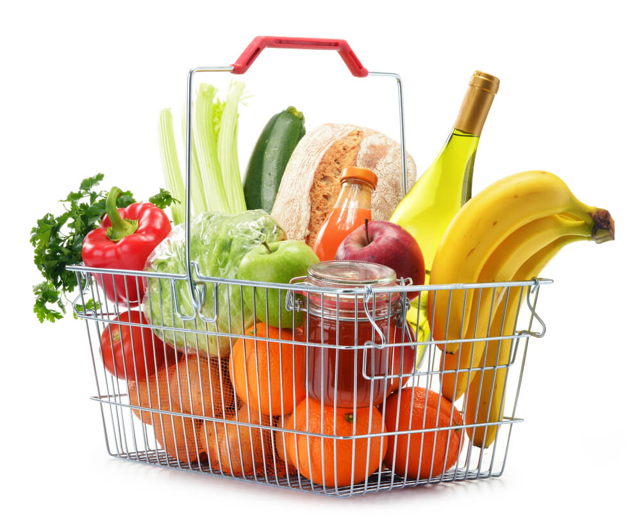
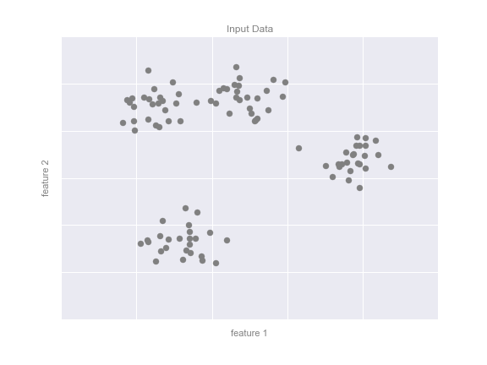
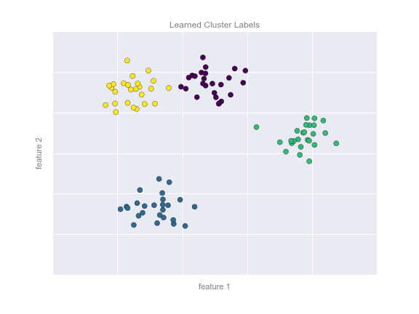
Clustering: Inferring labels on unlabeled data
Models that detect and identify distinct groups in the data by similarity. The similarity is always determined by a distance metric (es: euclidean distance)
The optimal centers are assumed to be those that minimize the distance of each point from its assigned center.

Slide 36
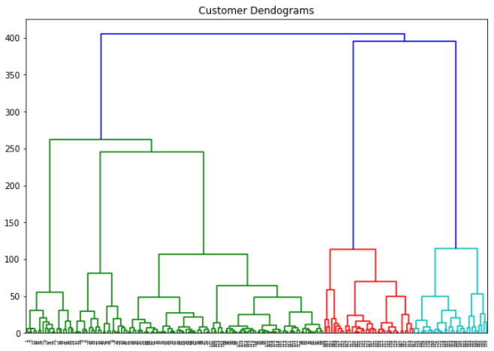
Clustering: Inferring labels on unlabeled data
The most common and famous UL technique is clustering. Clustering means grouping element by similarity so that each cluster, inside, is homogeneous.
For example in retail: we have an ecommerce and we have data from a lot of customers (sex, age, address, what they bought in the past...etc etc).
We would like to send a marketing campaign to them. So,
We clusterize the customers based on similarity of purchase and anagraphic. Now each cluster contains very similar customers.
Study and analyze each cluster (group) to know more about them.
Send different campaigns to each cluster.

Slide 37
Dimensionality Reduction

Slide 38
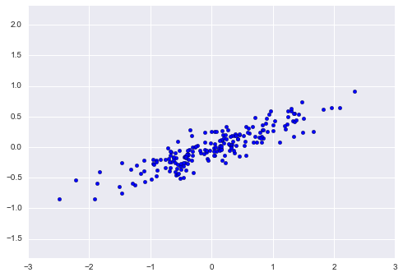
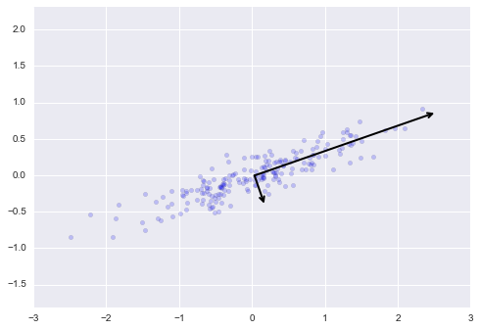
Linear Dimensionality reduction: Inferring structure of unlabeled data
Models that detect and identify lower-dimensional structure in higher-dimensional data
The data can be described now with only one axis (dimension) corresponding to the direction of the longest black arrow. Data can be projected from 2 dimension to 1 dimension (direction of the black longest arrow). The most common Linear Dimensionality Reduction technique is PCA (Principal Component Analysis)

Slide 39
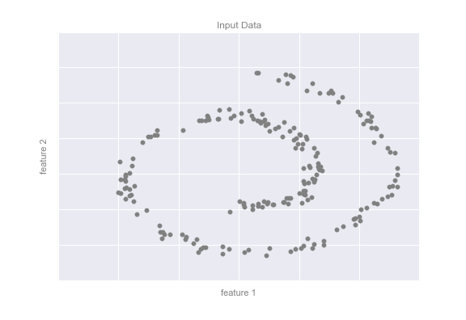
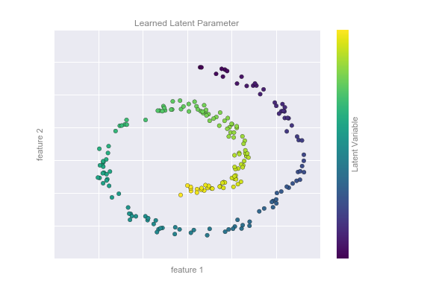
Non Linear Dimensionality reduction : Inferring structure of unlabeled data
Models that detect and identify lower-dimensional structure in higher-dimensional data
A one-dimensional line that is arranged in a spiral within this two-dimensional space. We could say that this data is "intrinsically" only one dimensional, though this one-dimensional data is embedded in higher-dimensional space.

Slide 40
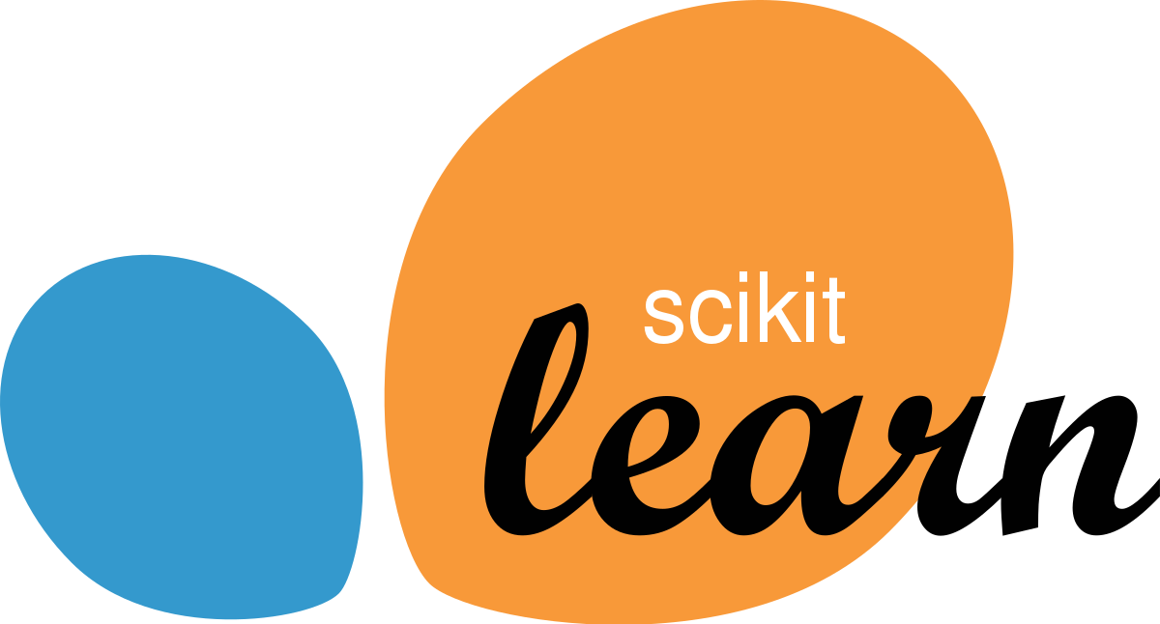
Sklearn: what is it?
Sklearn is a Python Library used for Machine Learning.
It has many many models and tools to do Machine Learning.
LINK
GitHub Link
We will use Sklearn because it is optimized for speed, but we will show you at the beginning what is under the hood of some simple algorithms.

